Slide 1
Predicting Hepatitis C Progression

Slide 2
Hepatitis c prediction model
Presenter; OGHENEFEJIRO JOAN OGHRE
Facilitators; Oluwole Olajide, Blessing Olorunfemi, Isaac Oyekunle.
DSA ML Project Report
7th JULY 2025

Slide 3

Study Background
Hepatitis C Virus (HCV) is a global health concern causing severe liver diseases.
It's often asymptomatic, leading to late diagnosis and poorer outcomes.
Early detection is crucial for effective treatment and preventing progression.
Machine learning offers a pathway to assist in timely identification.

Slide 4
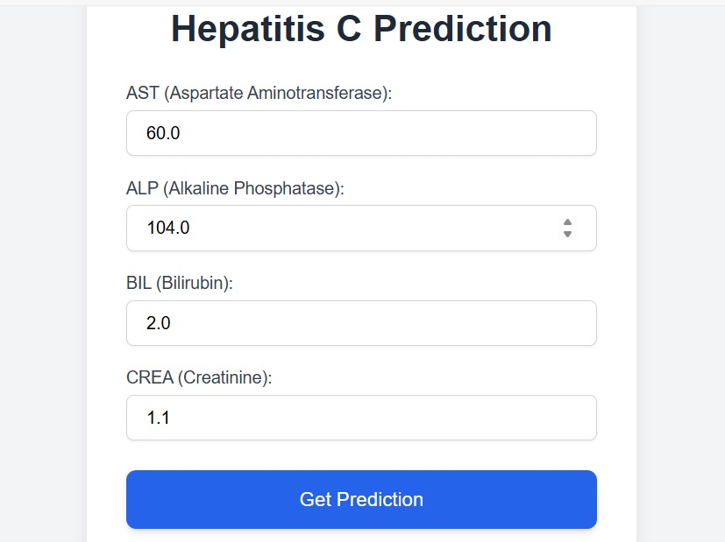
Problem Statement
Traditional diagnostic methods for Hepatitis C can be slow and resource-intensive.
Vast patient data exists, but extracting actionable insights manually is challenging.
There's a critical need for a rapid, data-driven tool to identify individuals at risk or those progressing through disease stages.
This project addresses the classification of patients into Hepatitis C progression categories.

Slide 5
Aim:
To develop and deploy a machine learning model for predicting Hepatitis C progression categories.
Objectives:
To preprocess and prepare the Hepatitis C dataset.
To identify key features for accurate prediction.
To train and evaluate a robust classification model.
To deploy the model as a user-friendly web API with a simple frontend.

Slide 6
Materials and methods
Materials and Methods
Data Source: HepatitisCdata.csv (Kaggle)
Preprocessing:
Missing value handling.
Categorical feature encoding.
Numerical feature scaling.
Feature Selection: Recursive Feature Elimination (RFE) to select top 4 features: AST, ALP, BIL, CREA.
Model: Logistic Regression (chosen for interpretability and efficiency).
Deployment: Flask web framework for API, HTML for frontend

Slide 7
Results
Model Performance:
Overall Accuracy: [Insert your model's actual accuracy, e.g., 91%]
F1-Score (Macro Avg): [Insert your model's actual F1-score, e.g., 0.53]
Category Predictions: Model classifies into Blood Donor (0), Hepatitis (1), Fibrosis (2), Cirrhosis (3), Suspect Blood Donor (4).
Deployed API: A functional Flask API successfully serves predictions locally via http://127.0.0.1:5000/predict.
Web Interface: A simple HTML form allows user input and displays predictions.

Slide 8
Model Performance
Overall Accuracy: 0.91 (or 91%)
F1-Score (Macro Avg): 0.53 (Indicates performance across all classes, treating minority classes equally)
F1-Score (Weighted Avg): 0.90 (Overall performance, weighted by class support)
Category | Precision | Recall | F1-Score | Support
Blood Donor (0) | 0.95 | 0.99 | 0.97 | 213
Hepatitis (1) | 0.67 | 0.20 | 0.31 | 10
Fibrosis (2) | 0.29 | 0.25 | 0.27 | 8
Cirrhosis (3) | 0.73 | 0.67 | 0.70 | 12
Suspect Blood Donor (4) | 0.50 | 0.33 | 0.40 | 3

Slide 9
Interpretation
While overall accuracy is high, the lower F1-scores for minority classes (Hepatitis, Fibrosis, Suspect Blood Donor) highlight areas for future model improvement, particularly in correctly identifying these less frequent but critical conditions.

Slide 10
Conclusion
Successfully developed and locally deployed a machine learning model for Hepatitis C progression prediction.
The project demonstrates the utility of ML in automating diagnostic assistance.
Key challenges in deployment setup were overcome, resulting in a functional prototype.
This model serves as a strong foundation for future enhancements and potential clinical integration.

Slide 11

Thank you for listening

